Slide 1

Implementation of a Java-Based Virtual Classroom System
Ch. Naga Sai Srikanth | Ch. Priyadarshini | B. Lahari Sri | N. Navya Sri Vasavi
192311159 | 192311118 | 192421421 | 192411204
CSA0927 - JAVA PROGRAMMING
Course Faculty : Dr Pushpa Latha S,
SIMATS Engineering, SIMATS

Slide 2

AGENDA
Abstract
Introduction
Problem Statement
Objectives
Literature Review
Proposed Methodology and Modules
Architecture
Concepts are used
Tools used
Results and Comparison
Conclusion and Future Enhancements
References
2

Slide 3
ABSTRACT
The project implements a Java-based Virtual Classroom System for online teaching and learning.
It provides secure, role-based access for Admin, Faculty, and Students.
Faculty can conduct live classes and share notes, PDFs, PPTs, and videos.
Students can submit assignments online and receive evaluation and feedback.
The system stores attendance, marks, and academic records in a MySQL database.
It improves accessibility, communication, and academic monitoring in a single platform.
3/27/2025
CAPSTONE PROJECT
3

Slide 4
INTRODUCTION
A Virtual Classroom System is an online platform that supports teaching and learning through the internet.
It enables students and faculty to interact without being physically present in the classroom.
The system allows teachers to upload study materials and conduct online classes.
Java provides a secure, reliable, and platform-independent environment for developing the application.
The system improves learning efficiency by integrating communication, assignments, and performance tracking.
It reduces dependency on manual, paper-based academic processes.
3/27/2025
CAPSTONE PROJECT
4

Slide 5
PROBLEM STATEMENT
Traditional classroom systems depend heavily on manual processes.
Managing attendance and assignments consumes significant time and effort.
Students have limited access to learning resources outside classroom hours.
Communication between teachers and students is often delayed or unorganized.
Manual record maintenance increases the possibility of errors and data loss.
An online system is needed to simplify academic activities and improve accessibility.
3/27/2025
CAPSTONE PROJECT
5

Slide 6
OBJECTIVES OF THE PROJECT
To develop a secure Java-Based Virtual Classroom System for online teaching and learning.
To implement User Management and Authentication for registration, login, and role-based access.
To provide Live Session and Content Sharing for virtual classes and learning resources.
To implement Assignment Submission and Evaluation with grading and feedback.
To generate Reports on attendance, assignments, and student performance.
To enable Group Discussion for collaborative learning among students.
/2025
CAPSTONE PROJECT
6

Slide 7
LITERATURE REVIEW
S.NO | DETAILS OF THE JOURNAL | ALGORITHM / METHODOLOGY USED | ADVANTAGES | DIS ADVANTAGES
1 | Web-Based Virtual Classroom System - IOSR Journal of Research & Method in Education, 2014 | JavaScript, MySQL, PHP, WAMP Server, Moodle and Elluminate for shared collaboration | Enables real-time group collaboration between remote students and tutors | Limited bandwidth lowers audio/video quality and session feedback
2 | Functional Requirements Analysis and Design of a J2EE Compliant Virtual Classroom Web App | J2EE three-tier architecture using Spring, JSF and Hibernate frameworks | Modular, configurable architecture supporting rapid application development | Acts only as a supplement to classroom teaching, not a full replacement
3 | A Java-Based Virtual Classroom for Continuous Learning in Enterprises - ResearchGate | HTML/Java system for management, delivery and consultation of courses | Supports continuous learning and structured course delivery for training | Designed mainly for enterprise training, limiting general classroom use
4 | Design and Implementation of a Virtual Classroom System - ResearchGate | Moodle, WAMP Server, JavaScript, MySQL and PHP based LMS | Aims to support LMS deployment in regions with limited infrastructure | Collaborative work quality is constrained by network/bandwidth limits
5 | Virtual Classroom - Gurukul International Research Journal | Java-based system designed and evaluated for interactive remote learning | Provides an interactive platform suited to rising remote-learning demand | Evaluation scope is limited, so broader scalability needs more testing
3/27/2025
CAPSTONE PROJECT
7

Slide 8
STEPS OF PROPOSED METHODOLOGY
Develop a centralized Java-based Virtual Classroom System.
Allow secure login with role-based access for different users.
Conduct online classes and share learning materials digitally.
Enable online assignment submission and automated evaluation.
Store attendance, marks, and academic records in a MySQL database.
Provide dashboards for easy monitoring of academic activities.
3/27/2025
CAPSTONE PROJECT
8

Slide 9
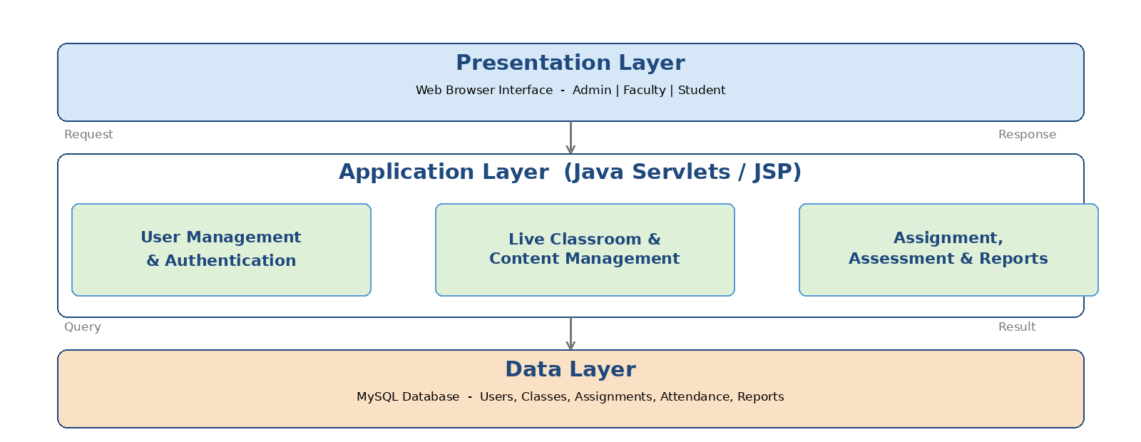
PROPOSED METHODOLOGY
3/27/2025
CAPSTONE PROJECT
9

Slide 10
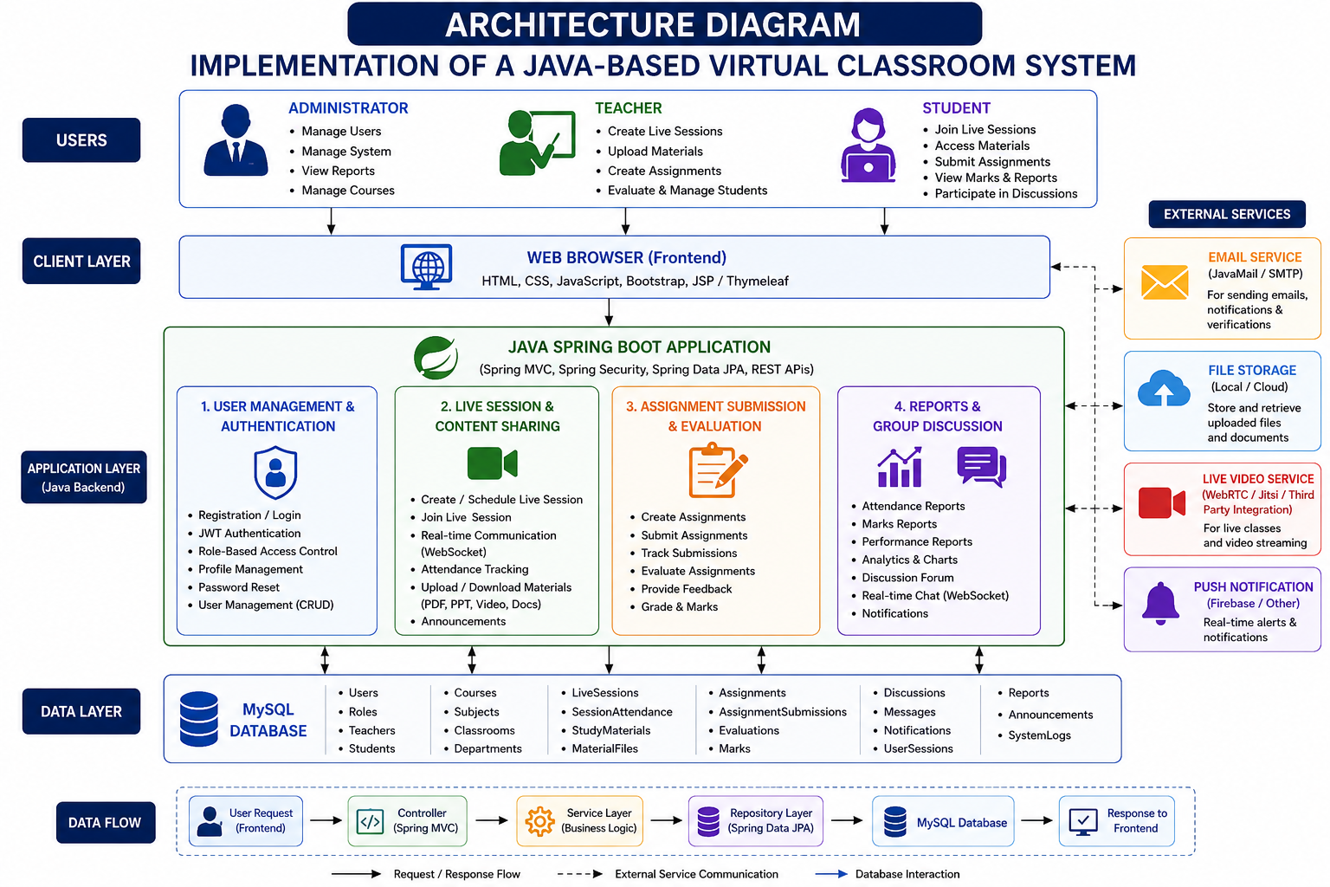
CAPSTONE PROJECT

Slide 11
JAVA CONCEPTS ARE USED IN THIS PROJECT
1. Classes & Objects → represent users, courses, assignments, reports, etc. 2. Encapsulation → protect user and assignment data. 3. Inheritance → Student, Teacher, and Admin can inherit from User. 4. Polymorphism → different users can perform different operations. 5. Interfaces → define common services such as authentication and classroom services. 6. Collections → store users, courses, assignments, questions, and messages. 7. Exception Handling → handle login, database, file, and input errors. 8. Multithreading → support multiple users and real-time classroom activities. 9. Streams & Lambda Expressions → process and filter assessment/report data. 10. JDBC/JPA/Hibernate → connect the Java application with MySQL.
CAPSTONE PROJECT

Slide 12
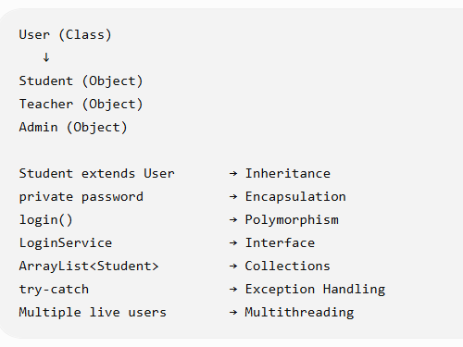
JAVA CONCEPTS ARE USED IN THIS PROJECT
Class → Blueprint for creating objects.
Object → Instance of a class.
Encapsulation → Protecting data by wrapping it with methods.
Inheritance → Acquiring properties from another class.
Polymorphism → One interface/method, different behaviors.
Interface → A contract that classes implement.
Collections → Store and manage groups of objects.
Exception Handling → Handling runtime errors safely.
Multithreading → Running multiple tasks concurrently.
CAPSTONE PROJECT

Slide 13
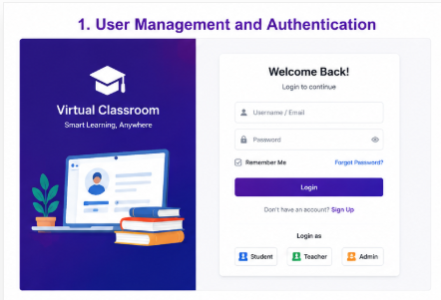
MODULE 1 - USER MANAGEMENT AND AUTHENTICATION
User Management : User Management is the process of creating, storing, updating, and managing users in the Virtual Classroom System.
Authentication: Authentication is the process of verifying the identity of a user before allowing them to access the Virtual Classroom System.
The User Management and Authentication module is used to manage all users of the Virtual Classroom System and provide secure access to the website. It mainly handles registration, login, user profiles, roles, password management, and logout.
It also supports profile management, password security,
account management, and logout.”
Java Concepts: Classes and Objects
EX:USER,TEACHER,STUDENT,ADMIN
13

Slide 14
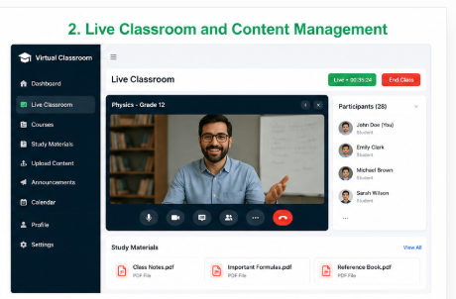
MODULE 2 - LIVE CLASSROOM AND CONTENT MANAGEMENT
The Live Classroom and Content Management module is used to conduct online classes and manage educational content in the Virtual Classroom System.
It allows Teachers to create and conduct classes and Students to join classes and access learning materials.
Live Classroom: A Live Classroom is an online classroom where teachers and students can interact in real time through the web application.
Content Management: Content Management is the process of uploading, organizing, updating, sharing, and accessing educational materials in the Virtual Classroom System.
Java Concepts:
Classes and Objects
EX: Classroom, Course, LiveSession
14

Slide 15
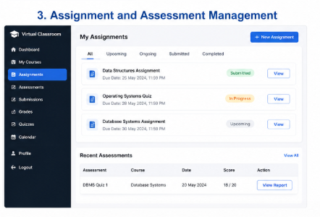
MODULE 3 - ASSIGNMENT, ASSESSMENT AND REPORTS
Assignment: An assignment is a task given by the teacher to students to complete and submit within a specified deadline.
Assessment: An assessment is a method used to evaluate the knowledge, understanding, and performance of students.
Reports: A report is a summary of a student's or class's academic performance.
The Assignment, Assessment and Reports module is used to manage student academic activities and evaluate their performance in the Virtual Classroom System. Teachers can create assignments and assessments, students can submit assignments and attend tests, and the system records and analyzes their performance.
Java Concepts:Classes and Objects ,Encapsulation
Inheritance , Polymorphism
EX: Assignment, Assessment ,Question Submission
15

Slide 16
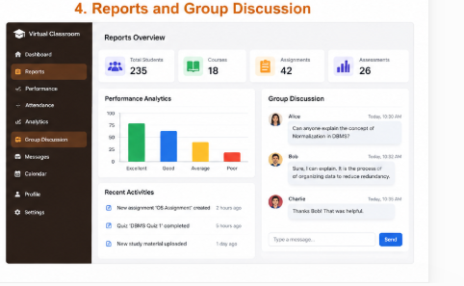
MODULE 4 - Reports And Group Discussion
Reports:Reports are organized summaries of student and classroom performance.
Group Discussion:Group Discussion is a communication feature that allows students and teachers to interact and share information about academic topics through messages.
The Reports and Group Discussion module is used to monitor student performance and provide a platform for students and teachers to communicate and discuss academic topics in the Virtual Classroom System.
Java Concepts:
Classes and Objects ,Interfaces ,Collections
EX: Report, Performance ,Attendance
16

Slide 17
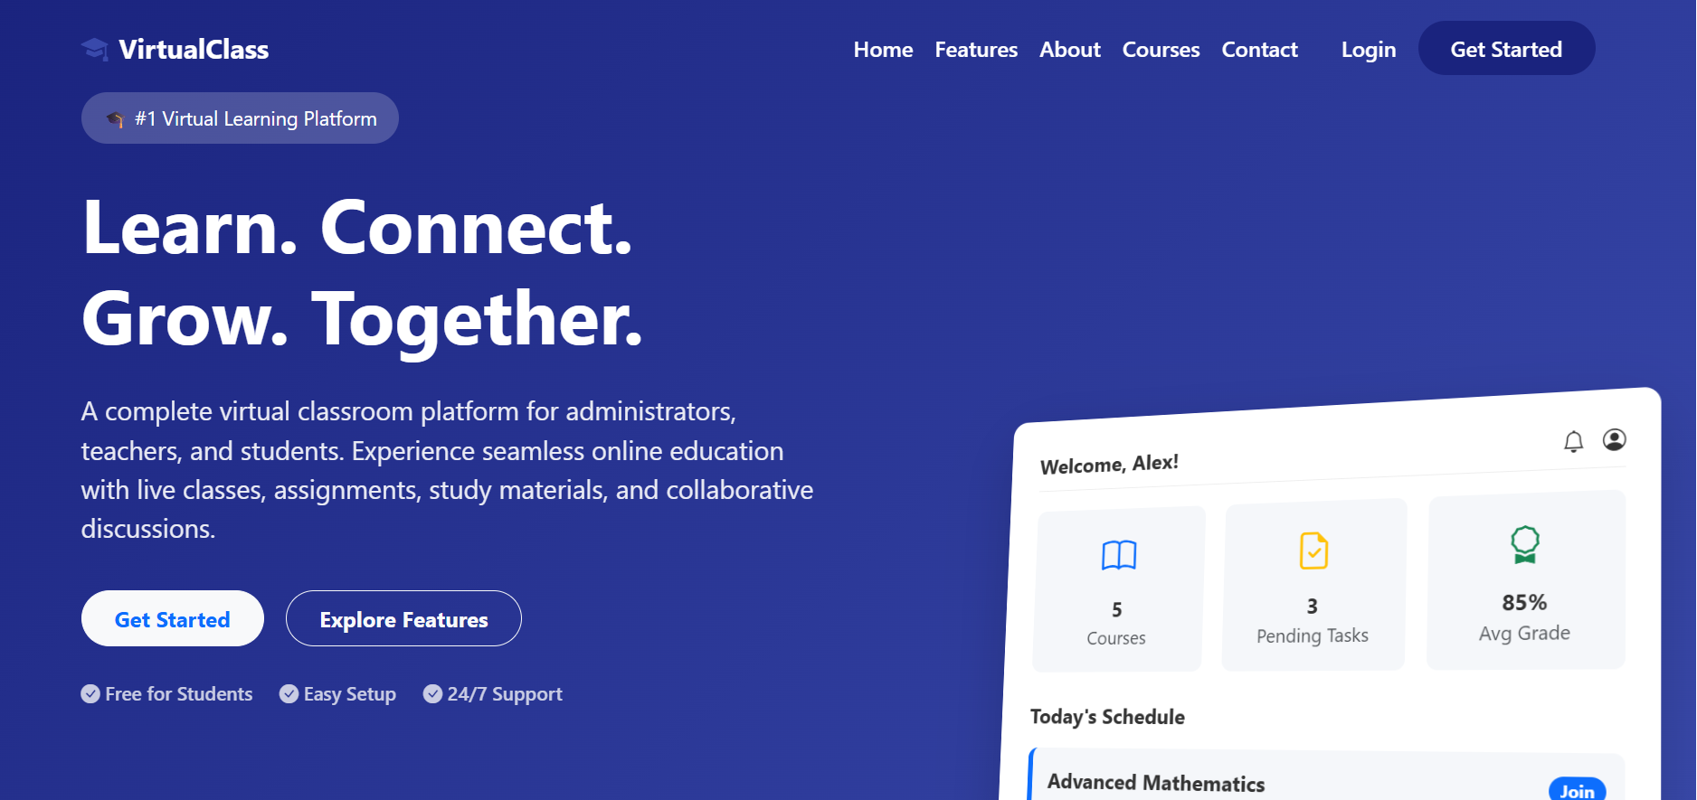
PROJECT DEMO

Slide 18
APPLICATIONS OF THE RESEARCH
Can be used by schools and colleges for regular online classes.
Useful for conducting remote assignments and evaluations.
Helps institutions manage student attendance and performance digitally.
Supports distance learning and skill development programs.
Can be extended for corporate training and e-learning platforms.
Assists in reducing paperwork and manual academic administration.
3/27/2025
CAPSTONE PROJECT
18

Slide 19
TOOLS USED
Module | Tools / Technologies Used
Frontend / Web UI | HTML5, CSS3, JavaScript, Bootstrap
Backend | Java
Backend Framework | Spring Boot
Web/API | Spring MVC, REST API
Database | MySQL
Database Connectivity | Spring Data JPA / Hibernate
Authentication | Spring Security, JWT
Live Classroom | WebRTC / WebSocket
Content Management | HTML, CSS, JavaScript + Spring Boot
Assignments & Assessments | Spring Boot + MySQL
Reports | Java + Spring Boot + Chart.js
Group Discussion | WebSocket / STOMP
Development IDE | IntelliJ IDEA / Eclipse / VS Code
Build Tool | Maven
Server | Apache Tomcat / Embedded Tomcat
Version Control | Git + GitHub
API Testing | Postman
Browser Testing | Google Chrome / Microsoft Edge
3/27/2025
CAPSTONE PROJECT
19

Slide 20
RESULTS AND DISCUSSION
Admin, Faculty, and Students can log in securely based on their assigned roles.
Faculty can create classes and upload study materials without difficulty.
Students can view materials, attend live sessions, and submit assignments online.
Assignment evaluation and feedback are recorded accurately in the database.
Attendance and performance reports are generated correctly for each student.
The group discussion module enables effective communication among users.
3/27/2025
CAPSTONE PROJECT
20

Slide 21
COMPARISON AND ANALYSIS
Existing methods rely on manual attendance; the proposed system automates attendance tracking.
Assignment submission is paper-based in existing methods but fully online in the proposed system.
Communication depends on notice boards, replaced here by an online group discussion module.
Student records are scattered across files but centralized in a MySQL database.
Existing methods offer no report generation; the proposed system provides automated reports.
Overall, the proposed system reduces errors, saves time, and improves accessibility.
3/27/2025
CAPSTONE PROJECT
21

Slide 22
CONCLUSION
The Java-Based Virtual Classroom System provides a centralized platform for academic activities.
It simplifies communication between students, faculty, and administrators.
The system reduces paperwork by digitizing attendance, assignments, and reports.
It improves accessibility by allowing learning from any location.
Secure data management ensures reliable storage of academic information.
Overall, the system enhances the efficiency and quality of modern education.
3/27/2025
CAPSTONE PROJECT
22

Slide 23
FUTURE ENHANCEMENTS
Integration of AI-based plagiarism detection for assignments.
Adding real-time video conferencing for live classes.
Mobile application support for Android and iOS.
Automated notifications through email and SMS.
Integration of analytics dashboards for deeper performance insights.
Support for multiple languages to reach a wider audience.
3/27/2025
CAPSTONE PROJECT
23

Slide 24
REFERENCES
Abraham Silberschatz, Henry F. Korth and S. Sudarshan (2021), Database System Concepts, 7th Edition, McGraw-Hill.
Oracle Corporation (2023), Java Platform, Standard Edition Documentation, Oracle.
Oracle Corporation (2024), MySQL 8.4 Reference Manual, Oracle.
VMware, Inc. (2024), Spring Boot Reference Documentation, VMware.
Oracle Corporation (2025), Java SE Development Kit Documentation, Oracle.
3/27/2025
CAPSTONE PROJECT
24

Slide 25
THANK YOU
3/27/2025
CAPSTONE PROJECT
25

